Slide 1
VGG16

Slide 2
VGG – Introduction
Paper : Very Deep Convolutional Networks for Large-Scale Image Recognition
- VGG -> Visual Geometry Group
- Also called as VGGNet
- Convolutional neural network model that supports 16 layers
- One of the top models in ILSVRC – 2014 competition
- VGG16 improves on Alexnet by replacing large filters with sequences of small 3x3 filters
The original purpose of VGG's research on the depth of convolutional networks is to understand how the depth of convolutional networks affects the accuracy of large-scale image classification and recognition.So in order to deepen the number of network layers and to avoid too many parameters, a small 3x3 convolution kernel is used in all layers.

Slide 3
Why use smaller conv layers?
Two consecutive 3x3 convolutions are equivalent to a 5x5 receptive field,
Three consecutive 3x3 convolutions are equivalent to a 7x7 receptive field.
Advantages of using three 3x3 convolutions instead of one 7x7 convolution are:
including three ReLu layers instead of one ,makes the decision function more discriminative (more non-linear mapping)
Reducing parameters . For example, the input and output are all C channels.
3 convolutional layers using 3x3 require 3x(3x3xC) = 27C, and
1 convolutional layer using 7x7 requires 1x(7x7xC)=49C. This can be seen as applying a kind of regularization to the 7x7 convolution, so that it is decomposed into three 3x3 convolutions.
The 1x1 convolution layer is mainly to increase the non-linearity of the decision function without affecting the receptive field of the convolution layer. Although the 1x1 convolution operation is linear, ReLu adds non-linearity.

Slide 4
Network Architecture
VGG 16
- Input RGB image size – 224x224
- Makes use of 3x3 and 1x1 filter sizes
- Convolution step size is fixed
Types:
- VGG11 = 8 conv layers + 3 fully connected layers
- VGG16 = 13 conv layers + 3 fully connected layers
- VGG19 = 16 conv layers + 3 fully connected layers
The overall structure includes 5 sets of convolutional layers, followed by a MaxPool.

Slide 5
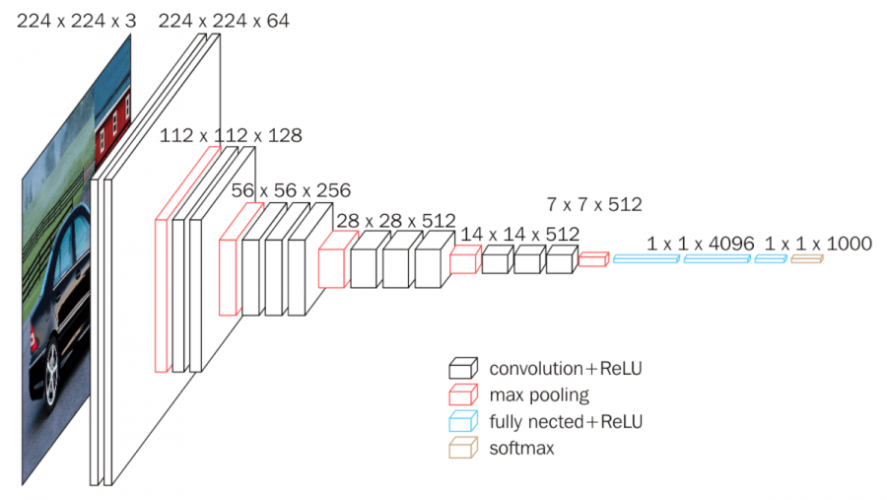
VGG16 Architecture

Slide 6
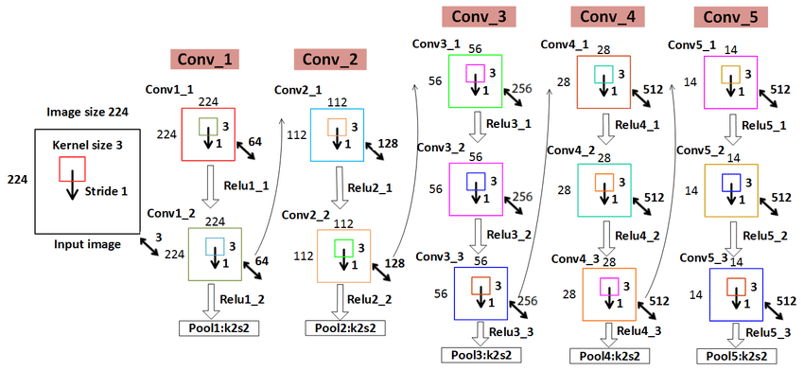
VGG16 Architecture

Slide 7
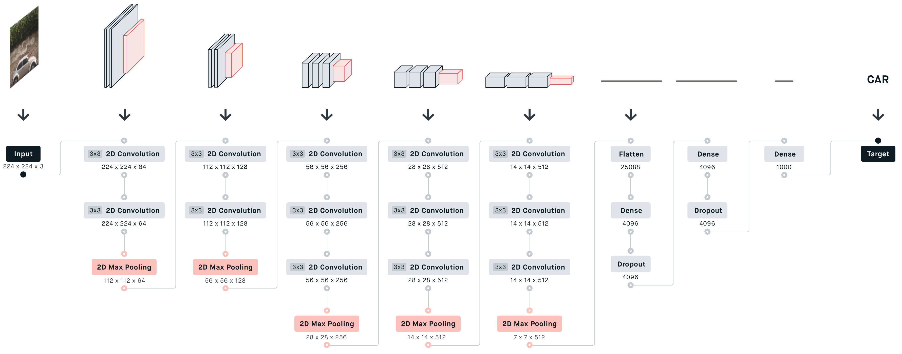
VGG16 Architecture

Slide 8
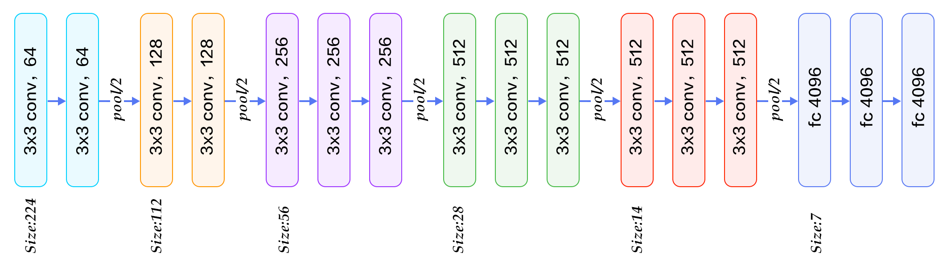
VGG16 Network

Slide 9
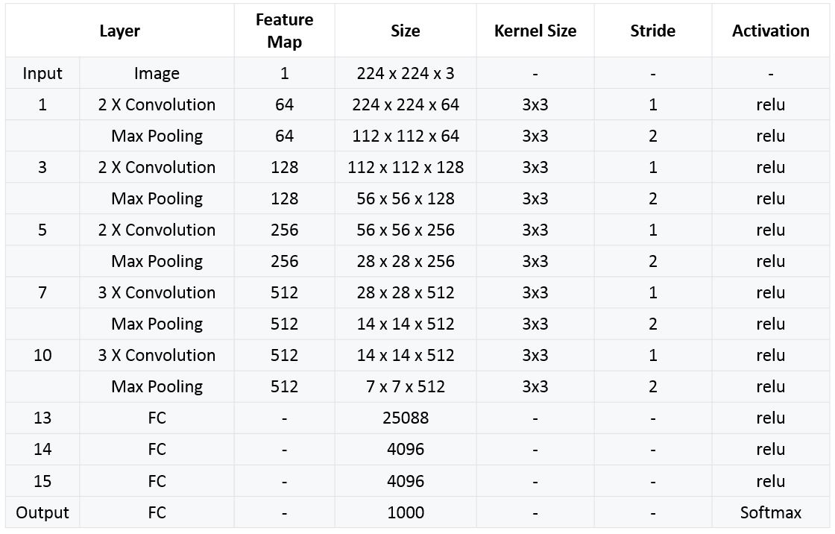
Comparison of various VGG models

Slide 10
References
- Kaggle VGGNet-16 Architecture: A Complete Guide
- Understanding VGG16: Concepts, Architecture, and Performance
- As the number of layers gets increased VGG suffers from vanishing gradient problem. To address this issue Resnet was developed.

